Slide 1
CSE331
AUTAMATA AND COMPUTABILITY
Lecture 11
Spring 2026

Slide 2
Today's learning goals Sipser Ch 1.4
Explain the limits of the class of regular languages
Justify why the Pumping Lemma is true
Apply the Pumping Lemma in proofs of non-regularity
Identify some nonregular languages

Slide 3
All roads lead to … regular sets?
Are there any languages over {0,1} that are not regular?
Yes: a language that is recognized by an NFA but not any DFA.
Yes: there is some infinite language of strings over {0,1} that is not described by any regular expression.
No: all languages over {0,1} are regular because that's what it means to be a language.
No: for each set of strings over {0,1}, some DFA recognizes that set.
I don't know.

Slide 4
Birds' eye view
All languages over Σ
Regular languages over Σ
Finite languages over Σ

Slide 5
Counting
There are more languages than regular languages
Conclusion: there must be non-regular languages
But how can we identify them???
All languages
Regular languages

Slide 6
Proving nonregularity
How can we prove that a set is non-regular?
Try to design a DFA that recognizes it and, if the first few attempts don't work, conclude there is none that does.
Prove that it's a strict subset of some regular set.
Prove that it's the union of two regular sets.
Prove that its complement is not regular.
I don't know.

Slide 7
Where we stand
There exist non-regular languages
If we know that some sets are not regular, we can conclude others are also not regular judiciously reasoning using closure properties of class of regular languages.
No example of a specific non-regular set ... yet.

Slide 8
Bounds on DFA
in DFA, memory = states
Automata can only "remember"…
  …finitely far in the past
  …finitely much information
If a computation path visits the same state more than once, the machine can't tell the difference between the first time and future times it visited that state.

Slide 9
Example!
{ 0^{n}1^{n} | n ≥ 0}
What are some strings in this set?
What are some strings not in this set?
Compare to L(0*1*)
Design a DFA? NFA?

Slide 10
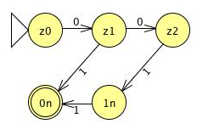
Example!
{ 0^{n}1^{n} | n ≥ 0}
What are some strings in this set?
What are some strings not in this set?
Compare to L(0*1*)
Design a DFA? NFA?

Slide 11
Pumping
Focus on computation path through DFA

Slide 12
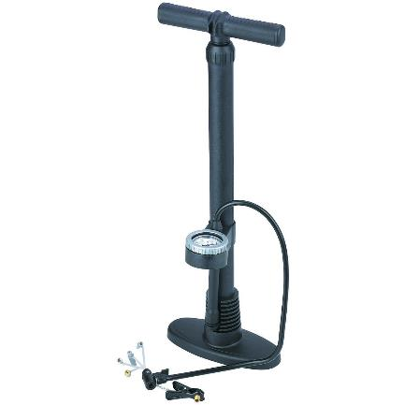
Pumping
Focus on computation path through DFA

Slide 13
Pumping
Focus on computation path through DFA
Idea: if one long string is accepted,
then many other strings have to be accepted too

Slide 14
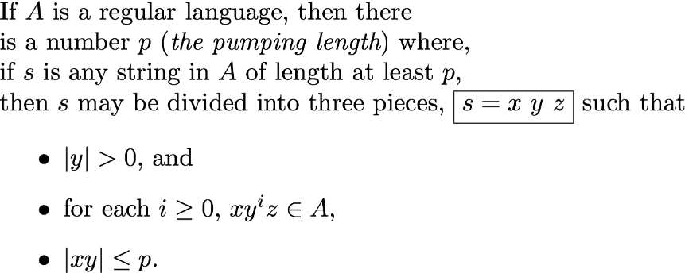
Pumping Lemma Sipser p. 78 Theorem 1.70

Slide 15
Pumping Lemma Sipser p. 78 Theorem 1.70
# states in DFA recognizing A
Transition labels along loop

Slide 16
Proof strategy
To prove that a language L is not regular
Assume towards a contradiction that it is.
Use Pumping Lemma to give p, a pumping length for L
Show that p actually isn't a pumping length for L.
→←
Conclude that L is not regular.

Slide 17
Using the Pumping Lemma
Claim: The set L = {0^{n}1^{n} | n ≥ 0} is not regular.

Slide 18
Using the Pumping Lemma
Claim: The set L = {0^{n}1^{n} | n ≥ 0} is not regular.
Proof:
Assume, towards a contradiction, that L is regular.
Pumping Lemma gives property of all regular sets. Can we get a contradiction by assuming that the Pumping Lemma applies to this set?

Slide 19
Using the Pumping Lemma
Claim: The set L = {0^{n}1^{n} | n ≥ 0} is not regular.
Proof:
Assume towards a contradiction L is regular.
So by Pumping Lemma, L has a pumping length, call it p.
FACT: p is a pumping length for L (by definition).
CLAIM: p is not a pumping length for L.
Conclude: contradiction!

Slide 20
Using the Pumping Lemma
Claim: The set L = {0^{n}1^{n} | n ≥ 0} is not regular.
Proof: …In particular, this means that every string in L that is of length p or more can be "pumped".
Goal: pick a string s in L of length greater than or equal to p such that any division of s as s =xyz with
|y|>0 and |xy|≤ p gives some value i≥0 with xy^{i}z not in L
So we have a contradiction, and L is not regular.

Slide 21
Using the Pumping Lemma
Claim: The set L = {0^{n}1^{n} | n ≥ 0} is not regular.
Proof: …
Goal: pick a string s in L of length greater than or equal to p such that any division of s as s =xyz with
|y|>0 and |xy|≤ p gives some value i≥0 with xy^{i}z not in L
Choose s = 0^{p}1^{p}. Consider any s = xyz with |y|>0, |xy|≤p.

Slide 22
Using the Pumping Lemma
Claim: The set L = {0^{n}1^{n} | n ≥ 0} is not regular.
Proof: …
Goal: pick a string s in L of length greater than or equal to p such that any division of s as s =xyz with
|y|>0 and |xy|≤ p gives some value i≥0 with xy^{i}z not in L
Choose s = 0^{p}1^{p}. Consider any s = xyz with |y|>0, |xy|≤p.
Since |xy|≤p, x=0^{k} , y = 0^{m} , z = 0^{r}1^{p} with k+m+r = p, m>0.

Slide 23
Using the Pumping Lemma
Claim: The set L = {0^{n}1^{n} | n ≥ 0} is not regular.
Proof: …
Goal: pick a string s in L of length greater than or equal to p such that any division of s as s =xyz with
|y|>0 and |xy|≤ p gives some value i≥0 with xy^{i}z not in L
Choose s = 0^{p}1^{p}. Consider any s = xyz with |y|>0, |xy|≤p.
Since |xy|≤p, x=0^{k} , y = 0^{m} , z = 0^{r}1^{p} with k+m+r = p, m>0.
Picking i=0: xy^{i}z = xz = 0^{k}0^{r}1^{p} = 0^{k+r}1^{p} , not in L!

Slide 24
Using the Pumping Lemma
Claim: The set L = {0^{n}1^{n} | n ≥ 0} is not regular.
Proof: …
Goal: pick a string s in L of length greater than or equal to p such that any division of s as s =xyz with
|y|>0 and |xy|≤ p gives some value i≥0 with xy^{i}z not in L
Choose s = 0^{p}1^{p}. Consider any s = xyz with |y|>0, |xy|≤p.
Since |xy|≤p, x=0^{k} , y = 0^{m} , z = 0^{r}1^{p} with m+n+r =p, m>0.
Picking i=0: xy^{i}z = xz = 0^{k}0^{r}1^{p} = 0^{k+r}1^{p} , not in L! This is a contradiction with the Pumping Lemma applied to L, so L must not be regular.

Slide 25


Slide 26
The pumping lemma game
The logic in applying the pumping lemma might seem confusing
Can think of it as a game between you (the prover) and an adversary (claiming that the language is regular)
Your goal is to prove that the adversary is wrong, and the language is not regular

Slide 27






Pumping lemma as a game
Two players: you (prover) and adversary
$p$ (pumping length)
$w∈L$ with $\left|w\right|≥p$
$w=xyz$ with $\left|xy\right|≤p,\left|y\right|≥1$
$i≥0$ such that $xy^{i}z∉L$

Slide 28
Pumping lemma as a game
Two players: you (prover) and adversary
$p$ (pumping length)
Your choices
Not your choices
$w∈L$ with $\left|w\right|≥p$
$w=xyz$ with $\left|xy\right|≤p,\left|y\right|≥1$
$i≥0$ such that $xy^{i}z∉L$

Slide 29
Another example
Claim: The set {a^{n}b^{m}a^{n} | m,n≥ 0} is not regular.
Proof: …Consider the string s = ……
You must pick s carefully: we want |s|≥p and s in L. Now we will prove a contradiction with the statement "s can be pumped"
Which choices of s cannot be used to complete the proof?
A. s = a^{p}b^{p} B. s = ab^{p}a C. s = a^{p}b^{p}a^{p} D. s = a^{p}ba^{p}
E. None of the above (all of these choices work).

Slide 30
Another example
Claim: The set {a^{n}b^{m}a^{n} | m,n≥ 0} is not regular.
Proof: …Consider the string s = ……
You must pick s carefully: we want |s|≥p and s in L. Now we will prove a contradiction with the statement "s can be pumped"
Consider an arbitrary choice of x,y,z such that s = xyz, |y|>0, |xy|≤p. This means that...What properties are guaranteed about x,y,z?
Consider i=… In this case, xy^{i}z = …, which is not in L, a contradiction with the Pumping Lemma applying to L and so L is not regular.

Slide 31
And another
Claim: The set {w w^{R} | w is a string over {0,1} } is not regular.
Proof: …Consider the string s = ……
You must pick s carefully: we want |s|≥p and s in L. Now we will prove a contradiction with the statement "s can be pumped" Consider i=…
Which s and i let us complete the proof?
A. s = 0^{p}0^{p}, i=2 B. s = 0110, i=0 C. s = 0^{p}110^{p}, i=1 D. s = 1^{p}001^{p}, i=3
E. I don't know

Slide 32
How do we choose i?
Claim: The set {0^{j}1^{k} | j,k ≥ 0 and j ≥ k } is not regular.
Proof: …Consider the string s = ……
You must pick s carefully: we want |s|≥p and s in L. Now we will prove a contradiction with the statement "s can be pumped" Consider i=…
Which s and i let us complete the proof?
A. s = 0^{p}1^{p}, i=2 B. s = 0^{p}1^{p}, i=p C. s = 0^{p}1^{p}, i=1 D. s = 0^{p}1^{p}, i=0
E. I don't know

Slide 33
Regular sets: not the end of the story
Many nice / simple / important sets are not regular
Limitation of the finite-state automaton model
  Can't "count"
  Can only remember finitely far into the past
  Can't backtrack
  Must make decisions in "real-time"
We know computers are more powerful than this model…
Which conditions should we relax?

Slide 34
The next model of computation
Idea: allow some memory of unbounded size
How?
  Generalization of regular expressions → Context-free grammars
  Generalization for DFA → Pushdown Automata

